Slide 1
Detection of Bot users in an online auction
Springboard Data Science Career Track
Christopher Gardner
February 8th, 2018

Slide 2
Problem and Client
Our client is a small online auction website. They have identified an issue with bot users pushing out the human bidders from being able to win bids.
Bot users are problematic in an auction setting because they can submit bids much faster than human bidders. Because of this bots can get the last bid and thus win the auction much easier than their human counterparts. This would cause a negative experience for human users which are never able to win any bids due to bots bidding faster than them.

Slide 3
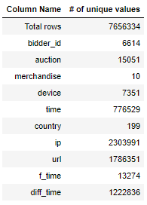
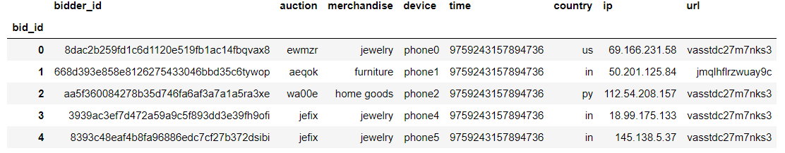
Data Wrangling: About the data
The data for this project is two sets of data one which includes information about different bids that have occurred in the auction and the second informs the user about which users are bots.
Above, sample of data points. Left, Number of unique values for each feature.

Slide 4
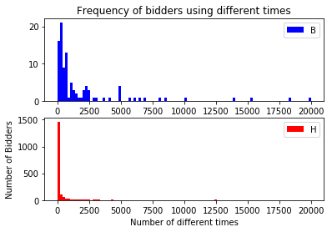
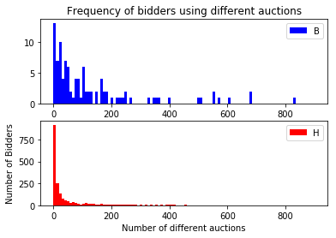
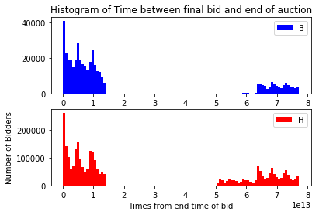
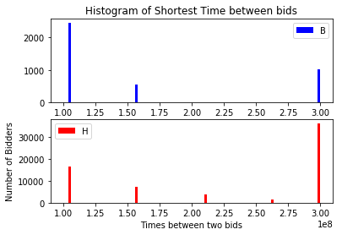
Data Wrangling: Histograms
The human and bot distributions for the “Time between final bid and end of auction” are very similar, thus we expect that it is not a useful feature. The other features have distinct shapes between the distributions and we will want to focus on these.

Slide 5
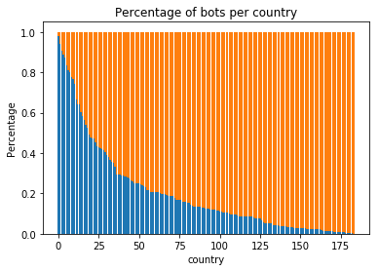
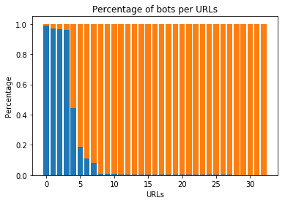
Data Wrangling: Stacked Bar Charts
Stacked bar charts let us determine if certain locations are significant indicators a bidder being a bot. Both of these features seem to have values which significantly indicate a user being a bot. However to obtain a plot URL data had to be truncated so much that only 5-10 urls having bots come from them is not useful. (1786351 unique URLs.

Slide 6
Inferential Statistics: t-test and chi-squared
Trends from data visualization are confirmed with statistics. URL was not useful and Country of bid was significant as expected (Right). Surprisingly the time between final bid and bid end is significant which we did not expect from visualization.
Feature | P-value | Significant
URL of bid | 0.89 | No
IP of bid | 1.00 | No
Country of bid | 0.0 | Yes
Feature | P-value | Significant
# of Auction | 4.7e-9 | Yes
# of total bids | 0.01 | Yes
# of bids / auction | 1.7e-8 | Yes
# of unique urls | 0.43 | No
Shortest time between bids | 0.0 | Yes
Final bid time -> bid end | 0.0 | Yes

Slide 7
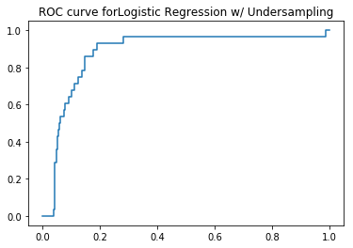
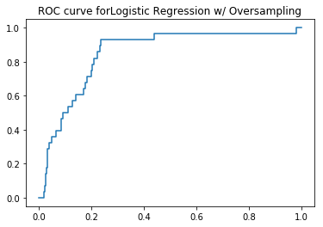
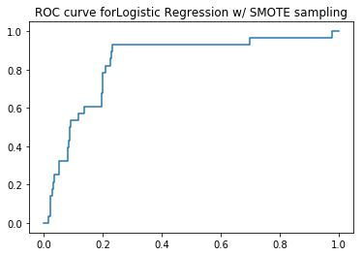
Machine Learning: Sampling Training data
The training data is skewed towards humans bidders (1328) which causes bot bidders (75) to be drowned out. Different sampling techniques are used to correct this and a few a compared below using AUC score as a determining factor. Undersampling is the most valuable sampling method shown with an AUC score of 0.88
AUC score: 0.880030181087
AUC score: 0.848214285714
AUC score: 0.835261569416

Slide 8

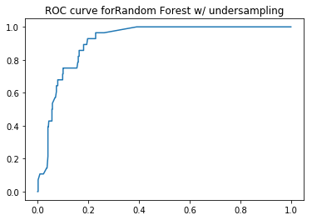
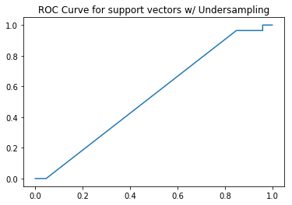
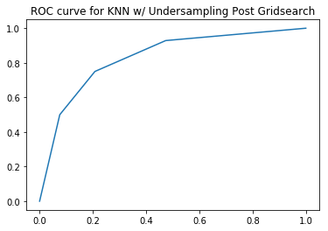
Machine Learning: Testing Models
Using undersampling as common method, the random forest model proved to have the best AUC score. However the logistic regression model was a close second so both will be analyzed more in depth.
AUC score: 0.880030181087
AUC score: 0.913135060362
AUC score: 0.773547535211
AUC score: 0.832180583501

Slide 9
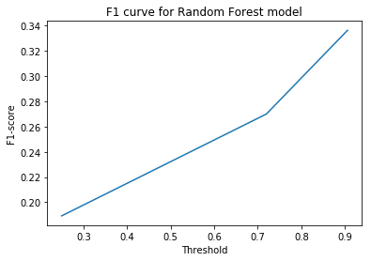
Final Thoughts
Logistic regression outperforms the random forest model in precision but not recall of bots. This represents random forest identifying more bots but logreg having less false positive bots. The client will need to determine which is the most useful to them.
Data | Precision | Recall | F1-Score | AUC Score
LogReg Bot | 0.22 | 0.86 | 0.35 | 0.88
Forest Bot | 0.19 | 0.89 | 0.31 | 0.91

Slide 10
Next Steps
Depending on the needs of the clients we will pursue optimizing the machine learning models to either minimize loss of human users (human recall) or maximize detection of bot users (bot precision). To do this we will have a few tasks.
Use gridsearch and thresholding to optimize the model with respect to the score which represents the client’s needs.
Implement systems of periodic classifications adding features for repeated bot classifications. This could improve bot precision assuming that the immediate banning of bots is not a major concern for the client.

